Slide 1
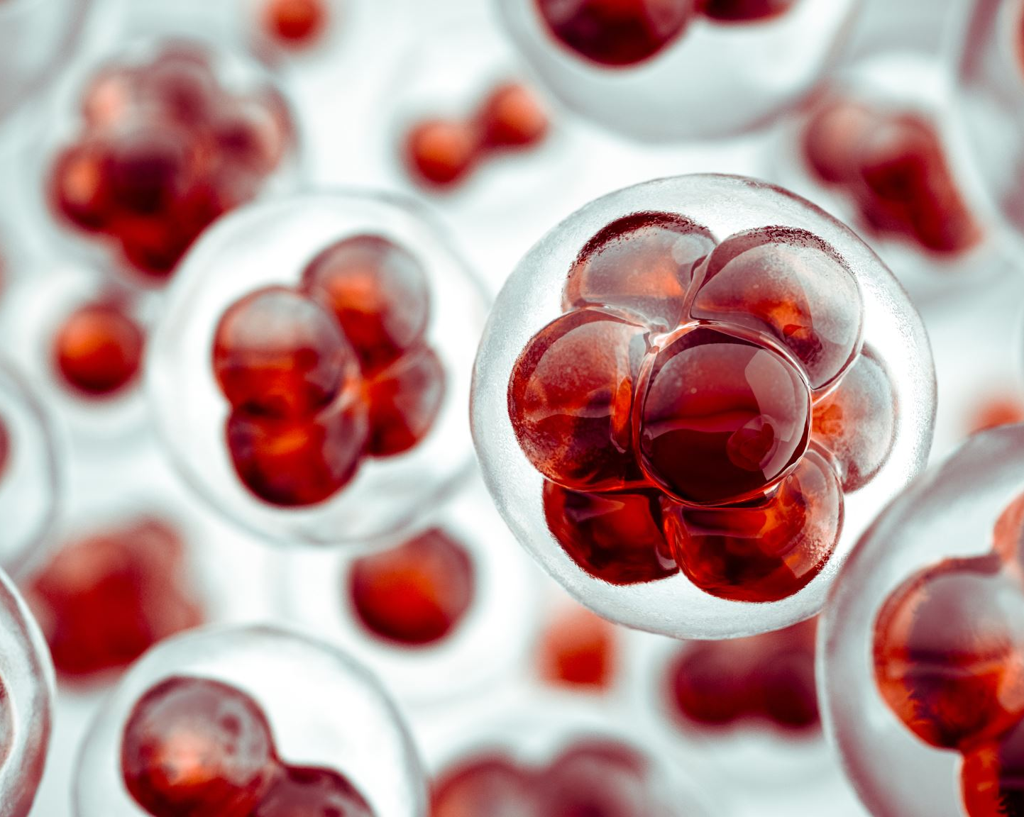
Melanoma
Snizhana Kurylyuk

Slide 2
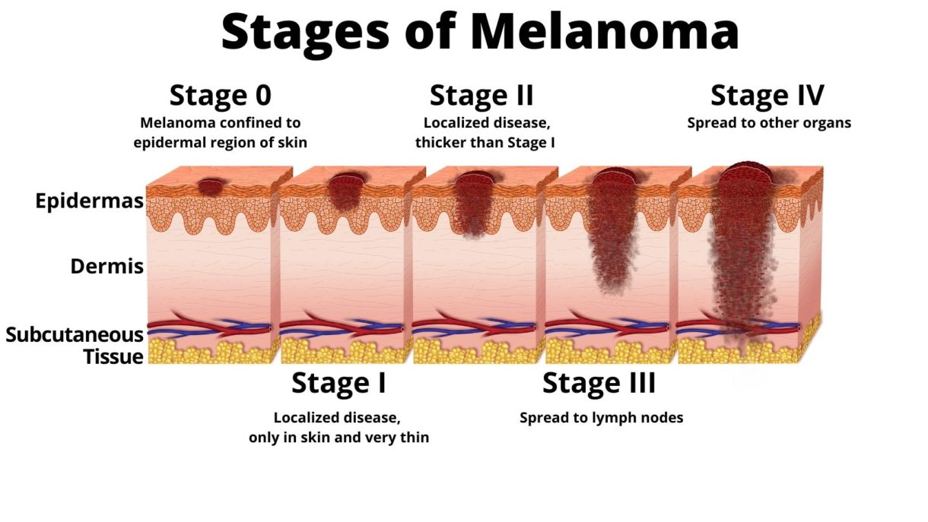
What Is Melanoma?
Among all the skin cancer type, melanoma is the least common skin cancer, but it is responsible for 75% of death from skin cancer.
Melanoma spreads very quickly to other body parts if not diagnosed early.
In the U.S., the percentage of people who develop melanoma has more than doubled in the past 30 years.
Between 2009 – 2019, the number of new invasive melanoma cases diagnosed in the U.S. is estimated to have increased by over 40%.
1 in 5 Americans will develop skin cancer by the age of 70.
More than 2 people die of skin cancer in the U.S. every hour.

Slide 3
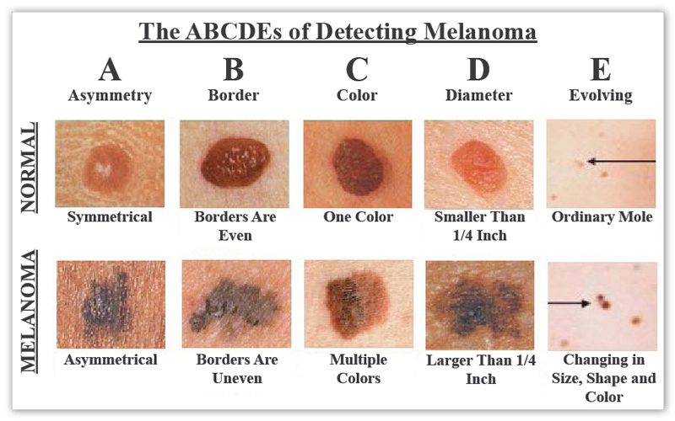
What can we do?
The International Skin Imaging Collaboration (ISIC) is facilitating skin images to reduce melanoma mortality. Melanoma can be cured if diagnosed and treated in the early stages.
The motivation is to develop a solution that can help dermatologists better support their diagnostic accuracy by ensembling contextual images and patient-level information, reducing the variance of predictions from the model.

Slide 4
Design
Data Preprocessing
Data Augmentation
Model Training
Hyperparameter tuning
Model Prediction

Slide 5
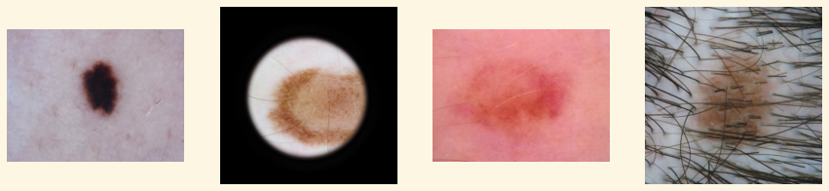
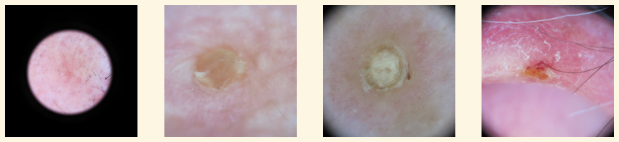
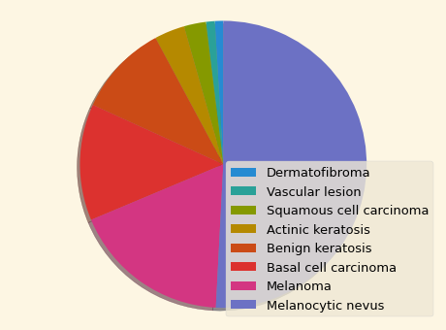
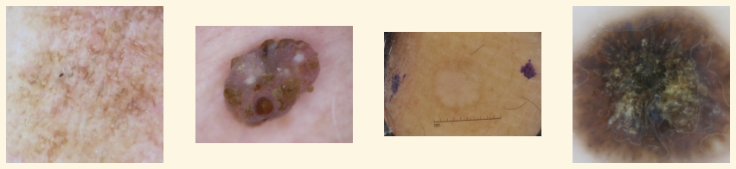
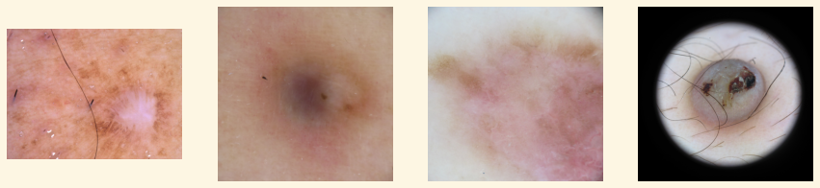
Melanocytic Nevus
Data produced by the International Skin Imaging Collaboration (ISIC). The ISIC Archive contains the largest publicly available collection of quality-controlled dermoscopic images of skin lesions with about 33,000 images
Actinic Keratosis
Benign Keratosis
Dermatofibroma

Slide 6
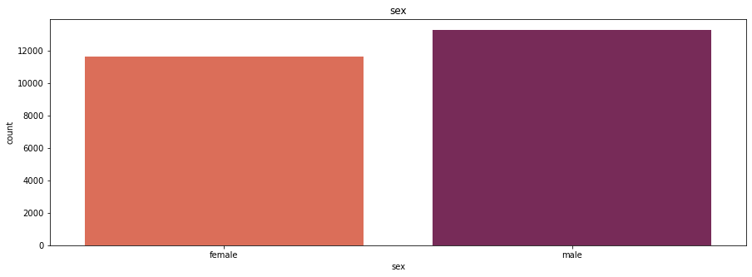
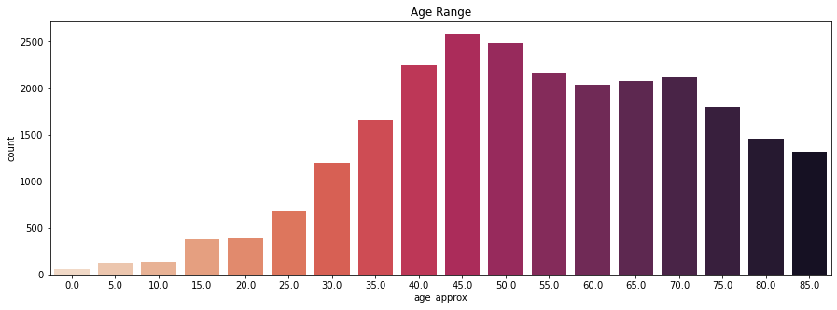
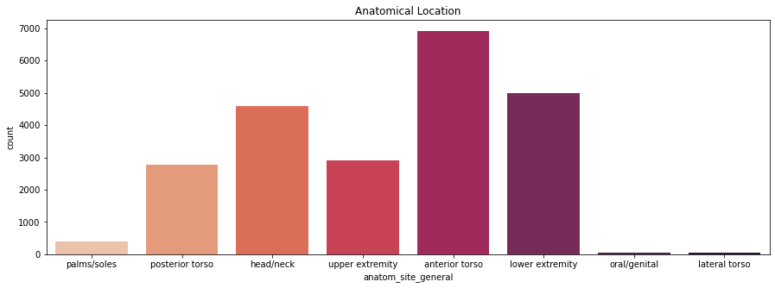
Exploratory Data Analysis

Slide 7

Data Augmentation
Rotation Range
Zoom Range
Brightness Range
Channel Shift Range
Fill mode
Horizontal Flip
Vertical Flip
Horizontal Zoom
Horizontal Shift
Shear
Notes:
Image augmentation is a technique of altering the existing data to create some more data for the model training process. In other words, it is the process of artificially expanding the available dataset for training a deep learning model.

Slide 8
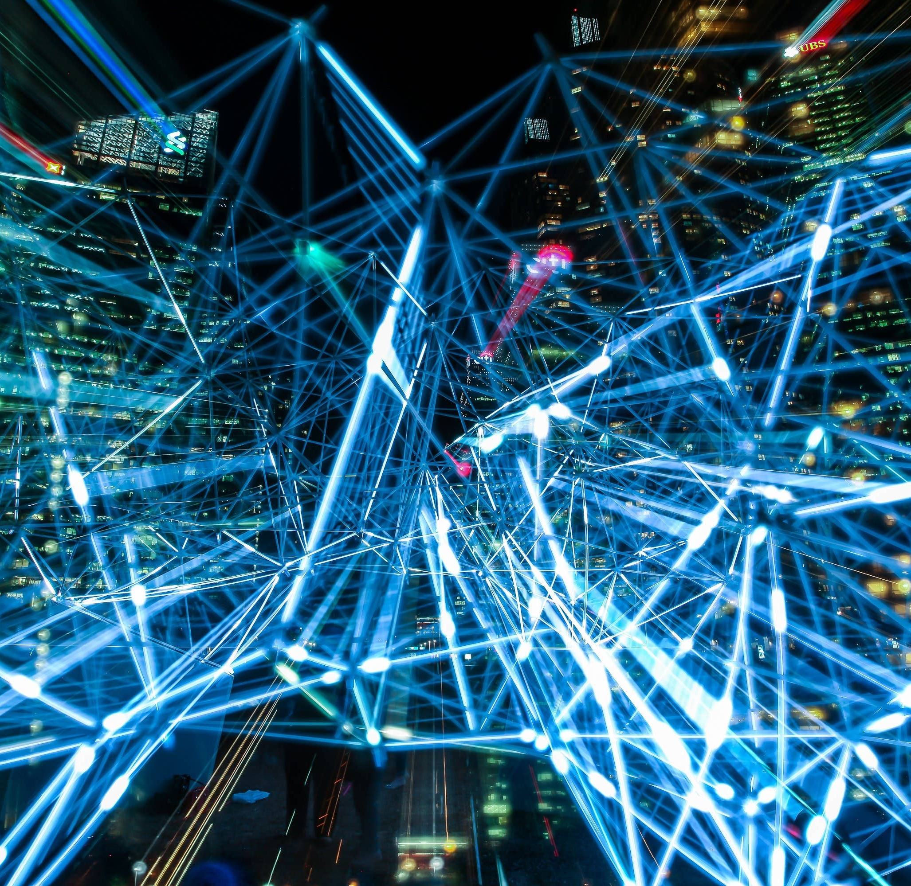
Model Training
Architectures
Baseline CNN
MobileNetV2 (Uses depthwise separable convolutions. It significantly reduces the number of parameters when compared to the network with regular convolutions with the same depth in the nets. This results in lightweight deep neural networks.)
ResNet (A residual neural network is an artificial neural network. Residual neural networks utilize skip connections, or shortcuts to jump over some layers.)
Classes
8 Classes
7 Classes
6 Classes
3 Classes –BEST MODEL

Slide 9
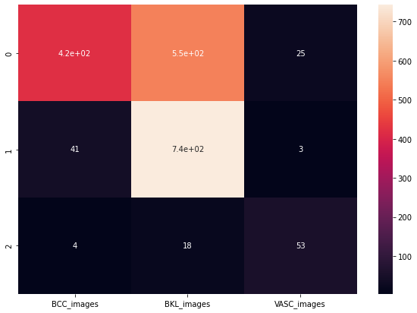
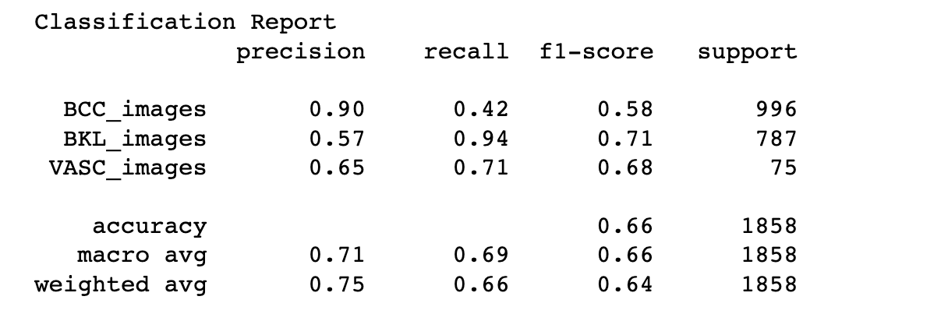
Model Analysis

Slide 10
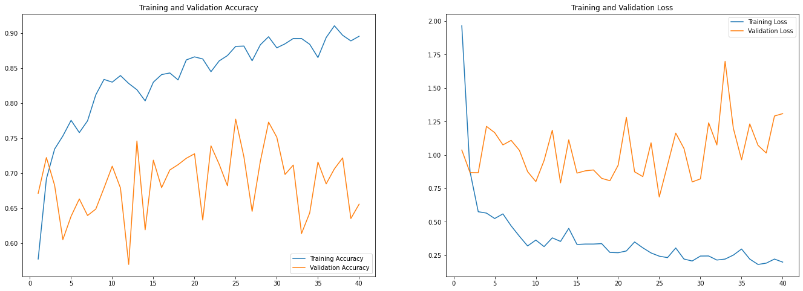
Model Accuracy

Slide 11
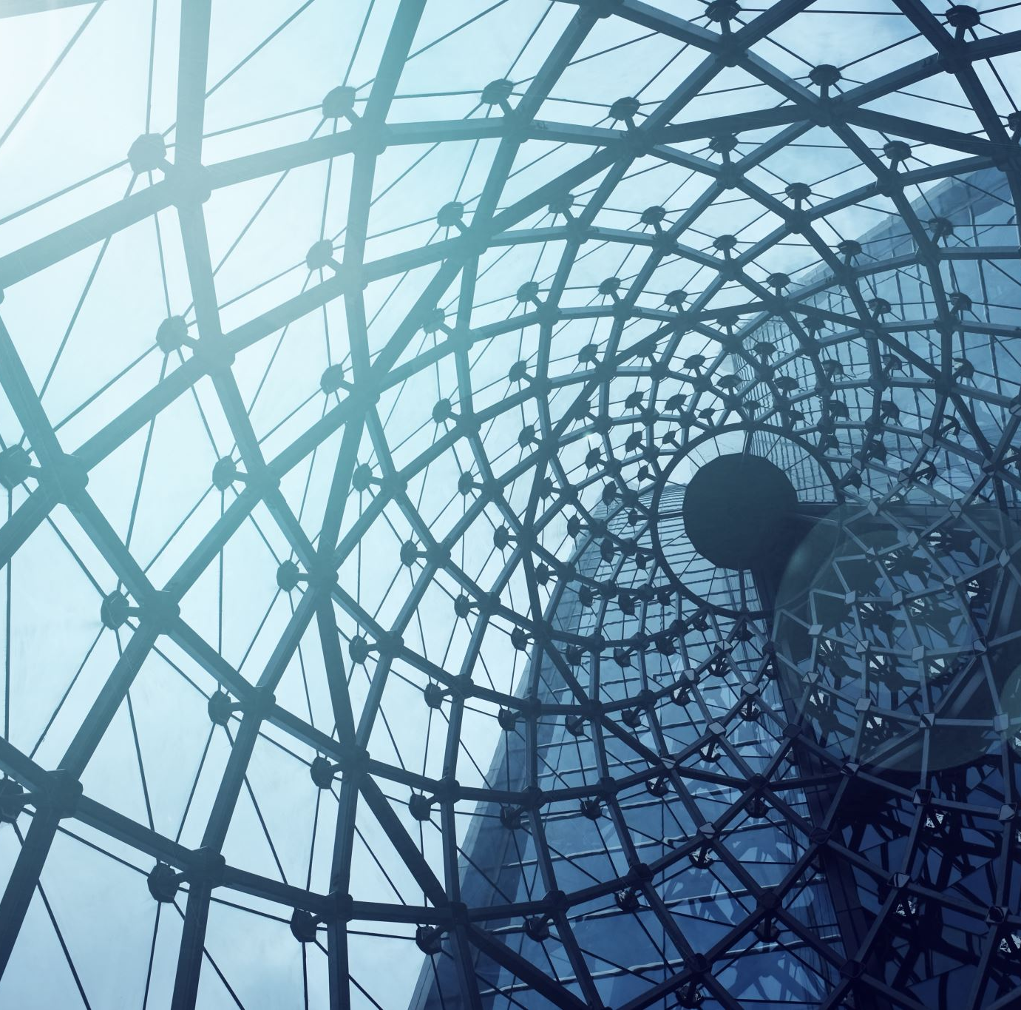
Future work
Additional image augmentation
Exploring different Neural Network Architectures
Explore cloud based platform for more efficient training

Slide 12


Questions

